Slide 1
FAKe news detection
Team members:
2010030046- E.pravallika
2010030168- Tahseen begum
2010030344- sowgna reddy
2010030445- P.keerthana

Slide 2
Introduction
The term “Fake News” was a lot less unheard of and not prevalent a couple of decades ago but in this digital era of social media. Fake news, information bubbles, news manipulation and the lack of trust in the media are growing problems within our society. However, to start addressing this problem, an in-depth understanding of fake news and its origins is required. Only then one can look into the different techniques and fields of machine learning (ML), natural language processing (NLP), and artificial intelligence (AI) that could help us fight this situation. “Fake news” has been used in a multitude of ways in the last half a year and multiple definitions have been given.

Slide 3
Objective
The main objective behind the development and up-gradation of existing projects are the following smart approaches:
• Be Aware of such articles while forwarding them to others
• Reveal True stories
• Prevent false crisis events
• Be Informative

Slide 4
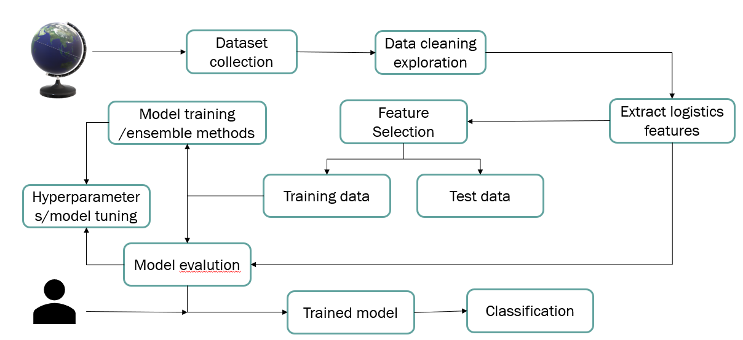
FlowChart

Slide 5
Methodology
The system is a Web application that helps the user to detect fake news. We have given the text box where the user has the option to paste the message or paste the URL link of the news and other message link and after that, it gives the reality of it. All the user gives data to the detector may save for further use to update the status of the model, and data analysis in the future. We also help users by giving some guidance on how to prevent such false events and how to stop such events fromspreading.

Slide 6
Implementation
LSTM: Long Short Term Memory
Techniques: Word Embedding: Word embedding is a set of language modeling and feature extraction techniques in Natural Language Processing (NLP). In word embedding, words from vocabulary are converted into vectors of real numbers. Word embedding is a type of word representation that allows words with similar meanings to have a similar representation.

Slide 7
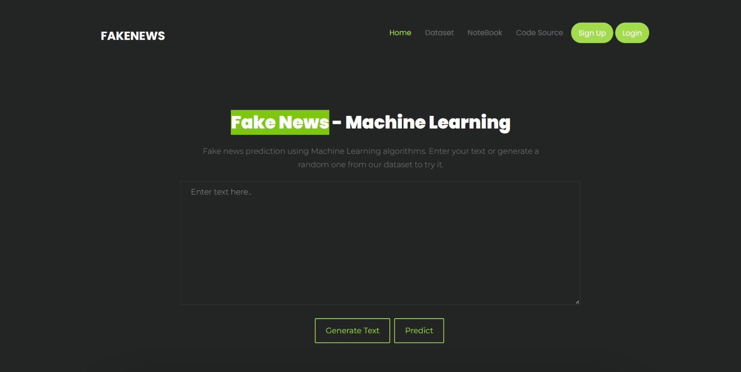
Result Analysis

Slide 8
Conclusion & Future Scope
With the help of Machine Learning, we have created 5 prediction model which gives an accuracy above 90% and it covers all the latest political covid 19 news. Also with some pre-trained models, we have covered news related to history and sport. We are intent to build our dataset which will be kept up to date according to the latest news in the future.
This project can be further enhanced to provide greater flexibility and performance with certain modifications whenever necessary. Deep fake learning can be a help detect fake images. Deep learning machine learning to get more accurate results.

Slide 9
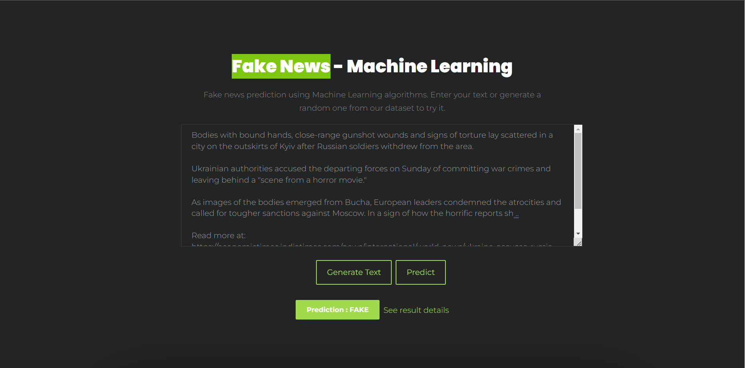
Execution Of the Project

Slide 10
